Slide 1
False positives in trans-eQTL and co-expression analyses arising from RNA-sequencing alignment errors
Ashis Saha PhD Candidate Johns Hopkins University
November 7, 2020

Slide 2
Outline
Background
Genetic variant
Gene expression
Co-expression network
Expression quantitative trait locus (eQTL)
Alignment errors produce false positives in trans-eQTL and co-expression studies.

Slide 3
Genetic variant

Slide 4
Cell
Nucleus
Chromosome (23 pairs)
DNA (3 billion base-pairs)
Gene (~20k)
Organism (Human)
Image source: http://neuroscience.mssm.edu/nestler/contecenter/signalingtothenucleus.html

Slide 5
DNA : A string of 4 letters
4 types of bases (or nucleotides)
Adenine (A)
Guanine (G)
Cytosine (C)
Thymine (T)
Forward strand : A G A C T G
Reverse strand : T C T G A C
A-T
G-C
5’
Forward
strand
3’
3’
Reverse
strand
5’

Slide 6
Genetic variant
Variant with A & G alleles
A G A C T G
Single Nucleotide Polymorphism (SNP)
5’
A G A C A G
A G G C A G
A G A C A G
A G G C T G
A G A C A G
Forward
strand
3’
3’
Reverse
strand
5’
99.9% of DNA is same in all humans,
only 0.1% of DNA is variable among people.

Slide 7
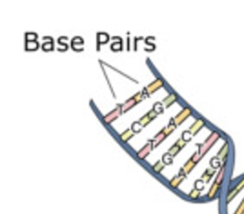
Genotype at a variant
A G A C T G
chr1
A G A C T G
chr1
A G A C T G
A G G C T G
A G G C T G
A G G C T G

Slide 8
Gene expression

Slide 9
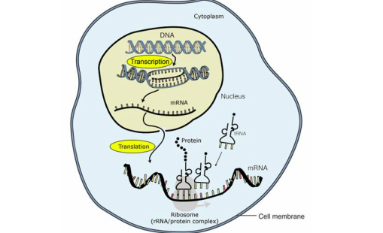
How does gene work?
DNA
DNA → RNA → Protein.
Gene expression
Number of transcripts (RNA) produced from a gene.
mRNA
Protein

Slide 10
Gene expression quantification using RNA-sequencing
C G T
RNA
T
A C T
cDNA
A C T T
Short reads (sequences)
Align to genome
Exon-1
Exon-2
Exon-3
Exon-4
Gene-1
Gene-2
16 reads
(transformed to TPM)
8 reads
(transformed to TPM)

Slide 11
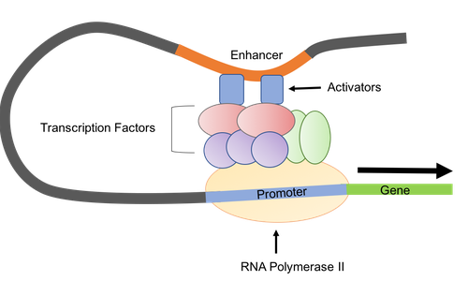
Regulation of gene expression
Variant
Transcription
Variant
Image source: www.addgene.org

Slide 12
Two types of gene expression regulation
TF
A / G
Gene
Variant
Gene
Regulation by other genes
Co-expression network
Regulation by genetic variants Expression quantitative trait locus (eQTL)

Slide 13
Co-expression network

Slide 14
Co-expression network
G1
Understand mechanisms of complex biological systems.
Identify possible drug targets.
G2
G3
G4
G5
G6
G6
G8
Gene
Connected genes are associated

Slide 15
Thyroid cancer pathway in KEGG

Slide 16
Co-expression network
Edges:
Undirected &
Weighted.
Understand mechanisms of complex biological systems.
Identify possible drug targets.
* No edge means weight=0. * For simplicity, each node is considered as a different gene.

Slide 17
Expression Quantitative Trait Locus (eQTL)

Slide 18
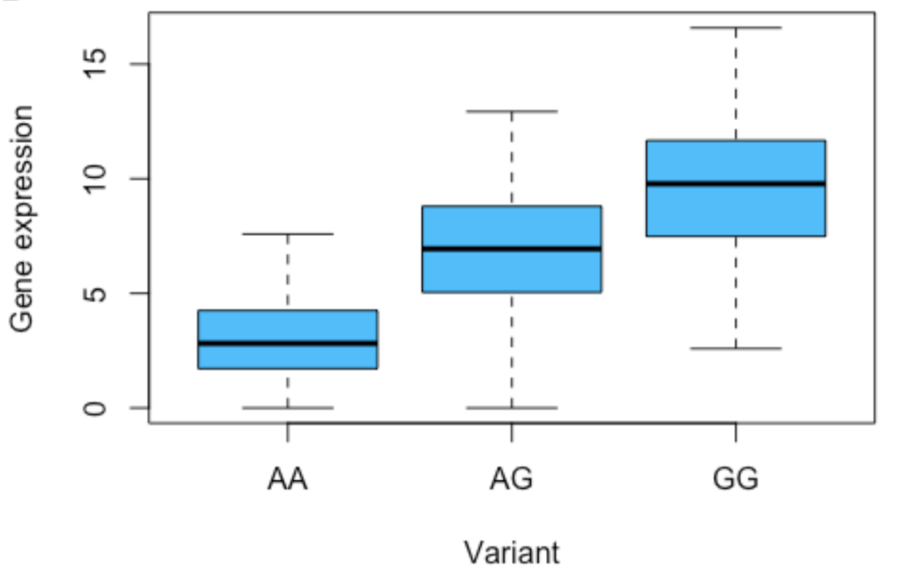
Expression quantitative trait locus (eQTL)
Genetic variant that explains variation in gene expression.
TF
TF
A / G
Variant
Gene

Slide 19
eQTL offers a potential mechanism of GWAS hits
A / G
Variant
A / G
Variant
Gene
eQTL
Variant
GWAS
Gene
Control
Case
Traits

Slide 20
Cis- and Trans-eQTL
chr1
Variant
chr1
Variant
Gene
chr2
d ≤ 1Mb
Gene
Cis-eQTL
The variant is nearby the gene.
Small number of statistical tests needed.
Trans-eQTL
The variant is away from the gene.
Large number of statistical tests needed.
Small effect size.

Slide 21
Data

Slide 22
Genetic variant data:
 | Variant-A | Variant-B | Variant-C | … | …
Individual-1 |  | 0 (AA)
Individual-2 |  | 2 (GG)
Individual-3 |  | 1 (AG)
… |  | 0 (AA)
Gene expression data:
 | Gene-1 | Gene-2 | Gene-3 | …
Individual-1 |  |  | 2.5
Individual-2 |  |  | 7.2
Individual-3 |  |  | 10.7
… |  |  | 3.0

Slide 23
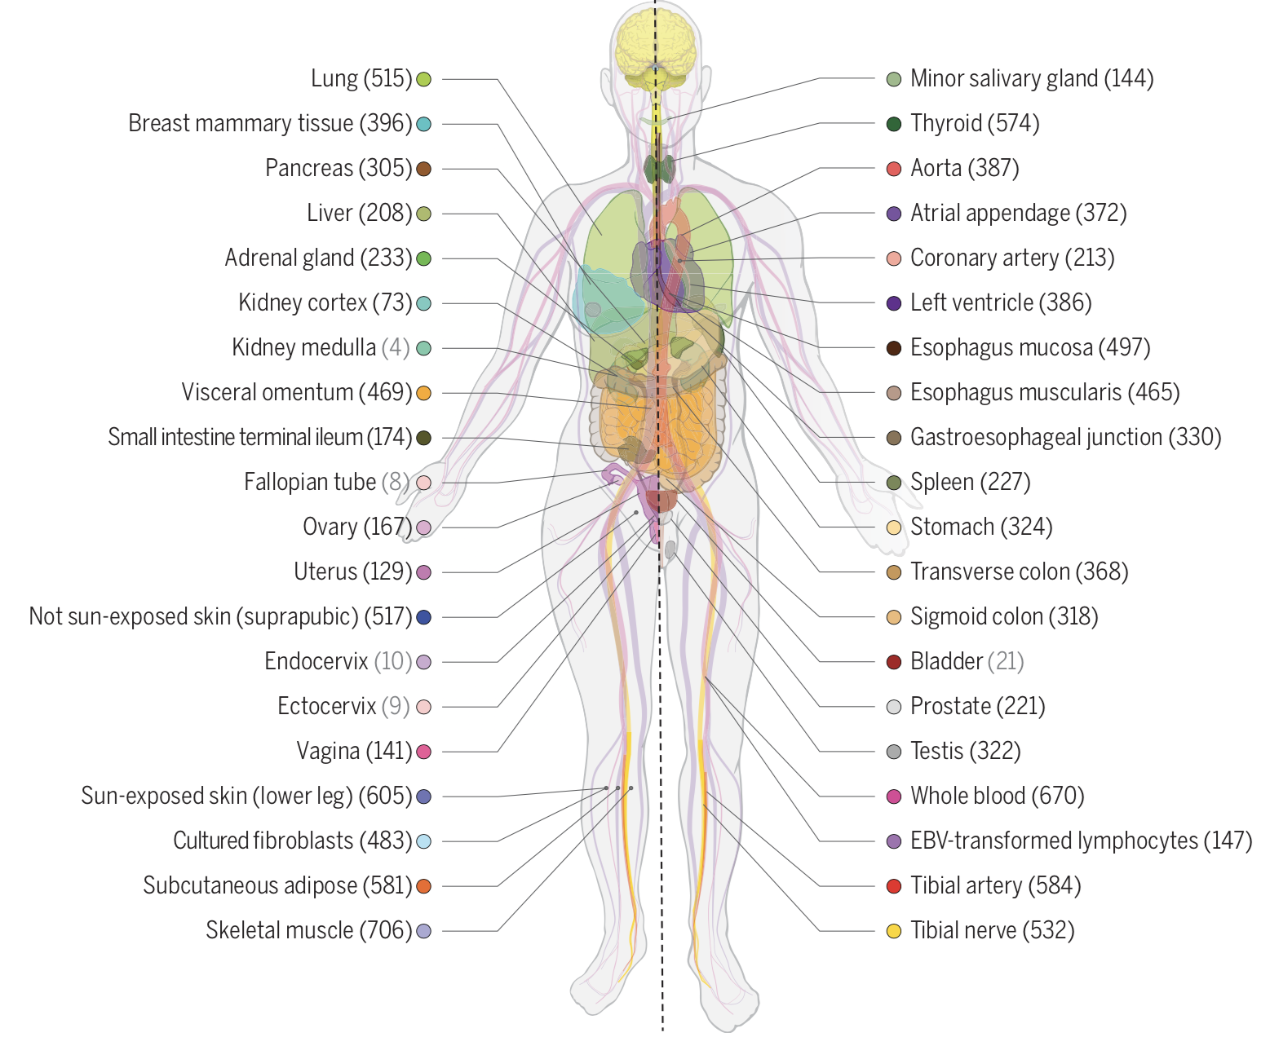
The Genotype-Tissue Expression Consortium
Largest database for DNA- and RNA-sequencing from humans.
838 individuals with genotypes.
15,253 RNA-seq samples from 54 tissues.

Slide 24
False positives due to alignment errors

Slide 25
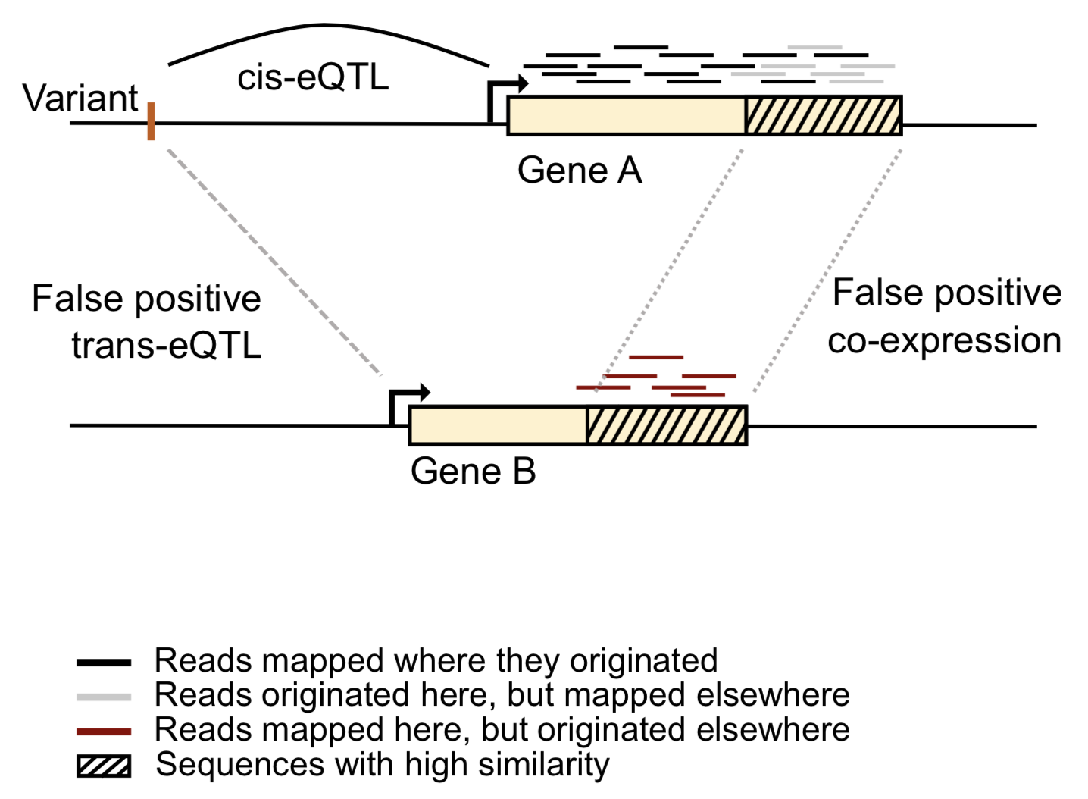
Alignment errors produce false positives in trans-eQTL and co-expression studies
“Cross-mappability”
Ref: Saha et al. (2018) F1000 Research.

Slide 26
Cross-mappability quantifies the potential for alignment errors
Number of Gene A’s k-mers whose alignment, allowing mismatches, start within exonic or untranslated regions of Gene B.
Ref: Saha et al. (2018) F1000 Research.

Slide 27
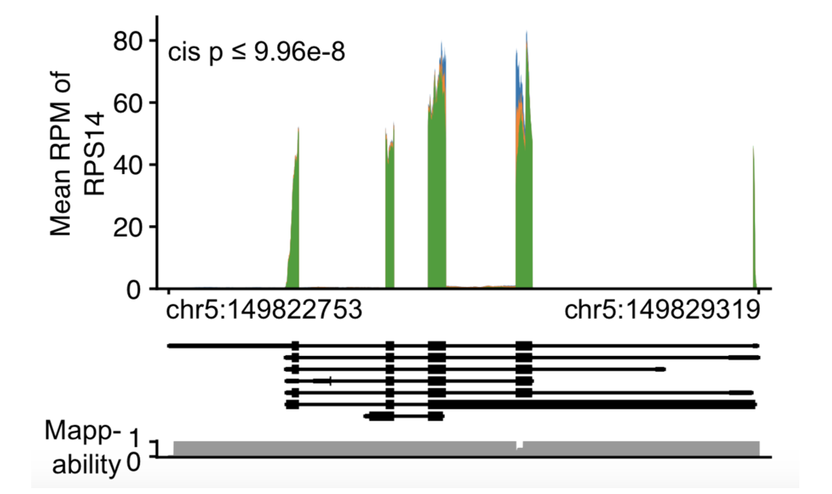
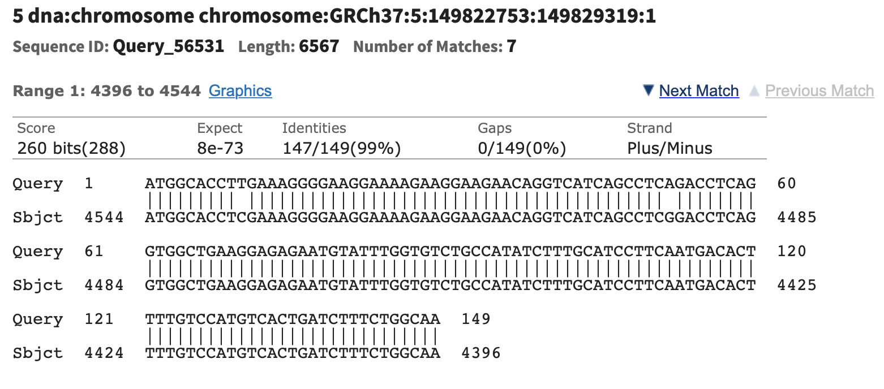
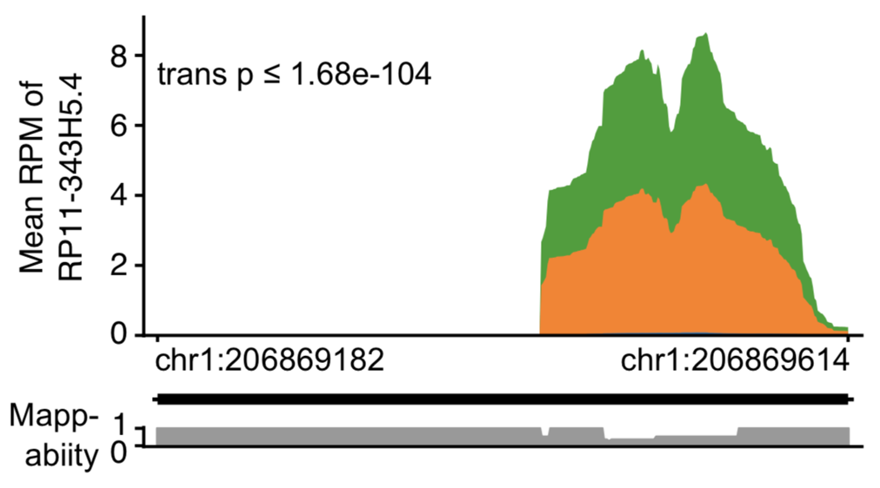
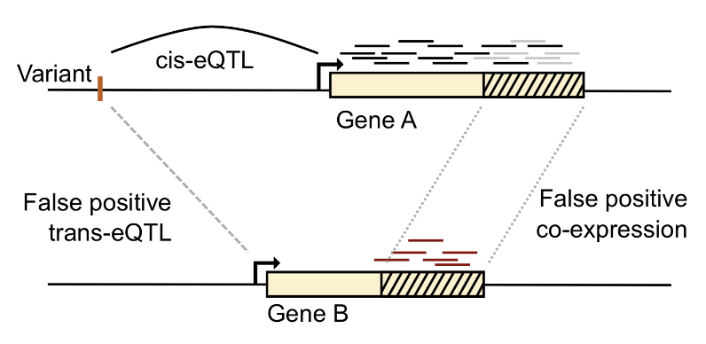
False trans-eQTL example
Ref: Saha et al. (2018) F1000 Research, https://blast.ncbi.nlm.nih.gov.

Slide 28
Abundance of cross-mappable trans-eQTLs in top hits suggests false positives
75%
A trans-eQTL is cross-mappable if there is a gene near the variant that cross-maps to the target gene (i.e. Crossmap: A→B > 0 ).
Ref: Saha et al. (2018) F1000 Research.

Slide 29
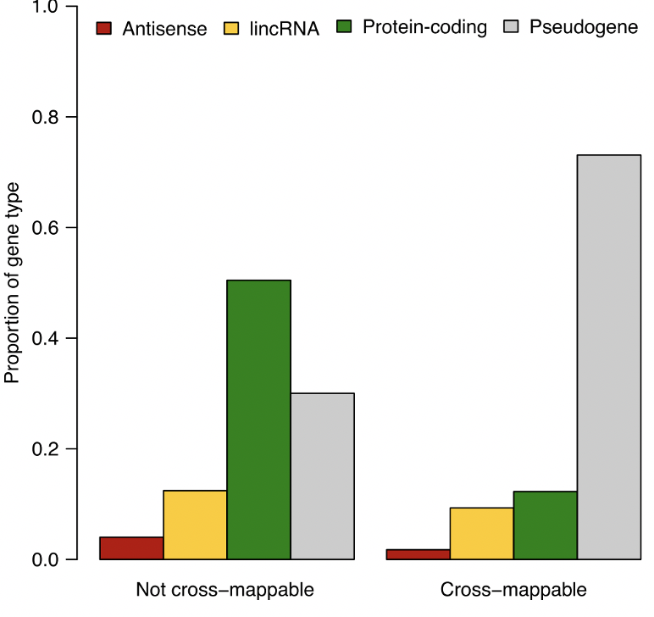
Pseudogenes are abundant in cross-mappable eQTLs

Slide 30
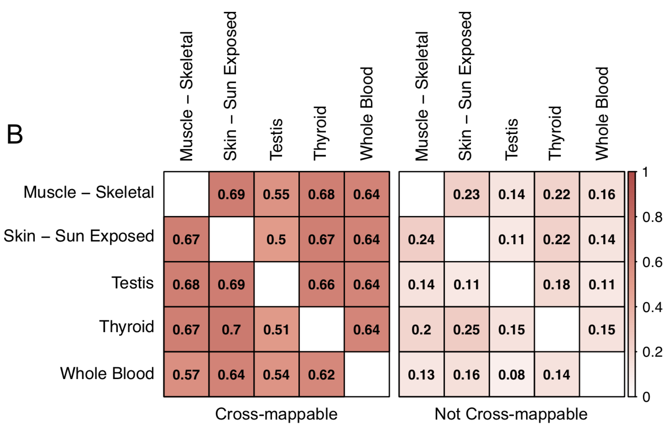
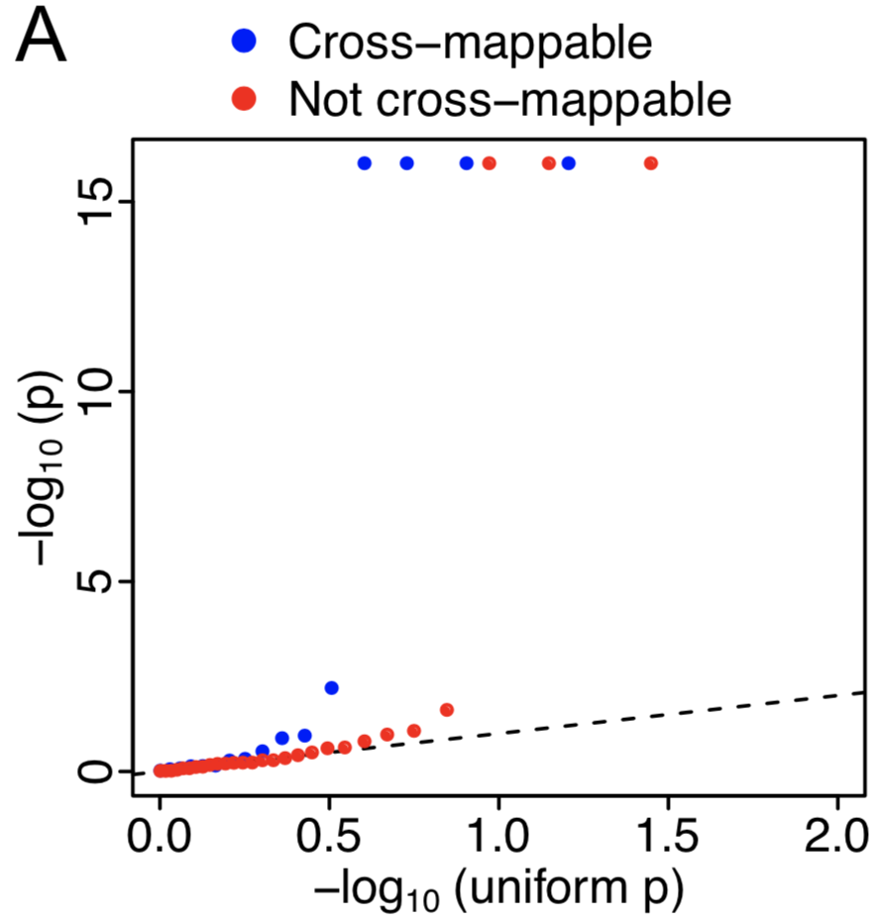
Replication studies may be misleading for cross-mappable eQTLs
Replication of GTEx whole blood eQTLs in DGN whole blood
Replication of one GTEx tissue eQTLs (rows) in another GTEx tissue (columns)
Ref: Saha et al. (2018) F1000 Research.

Slide 31
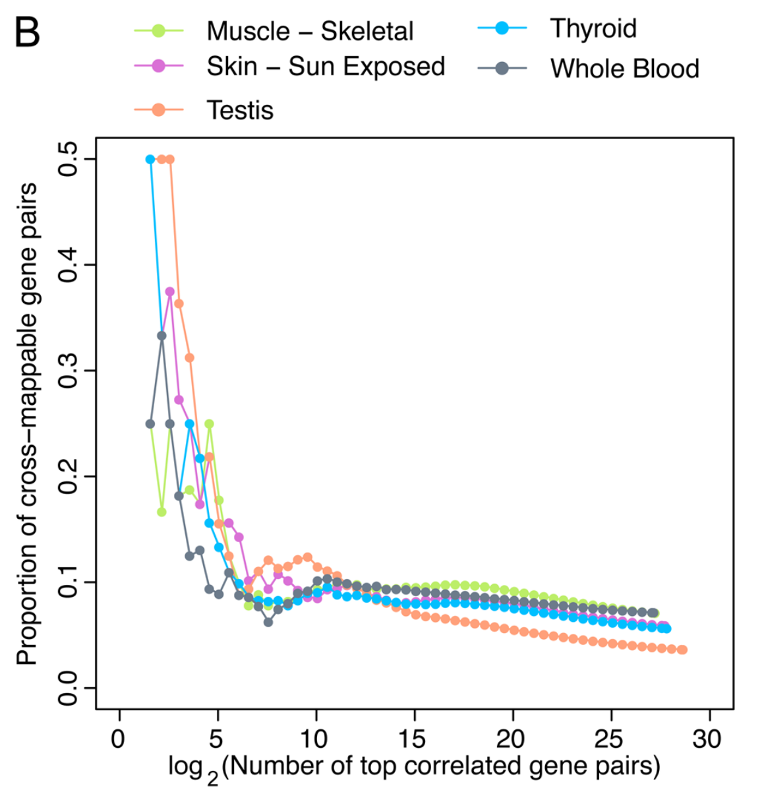
False positives in co-expression studies
Co-expression in 10,000 random gene pairs
Ref: Saha et al. (2018) F1000 Research.

Slide 32
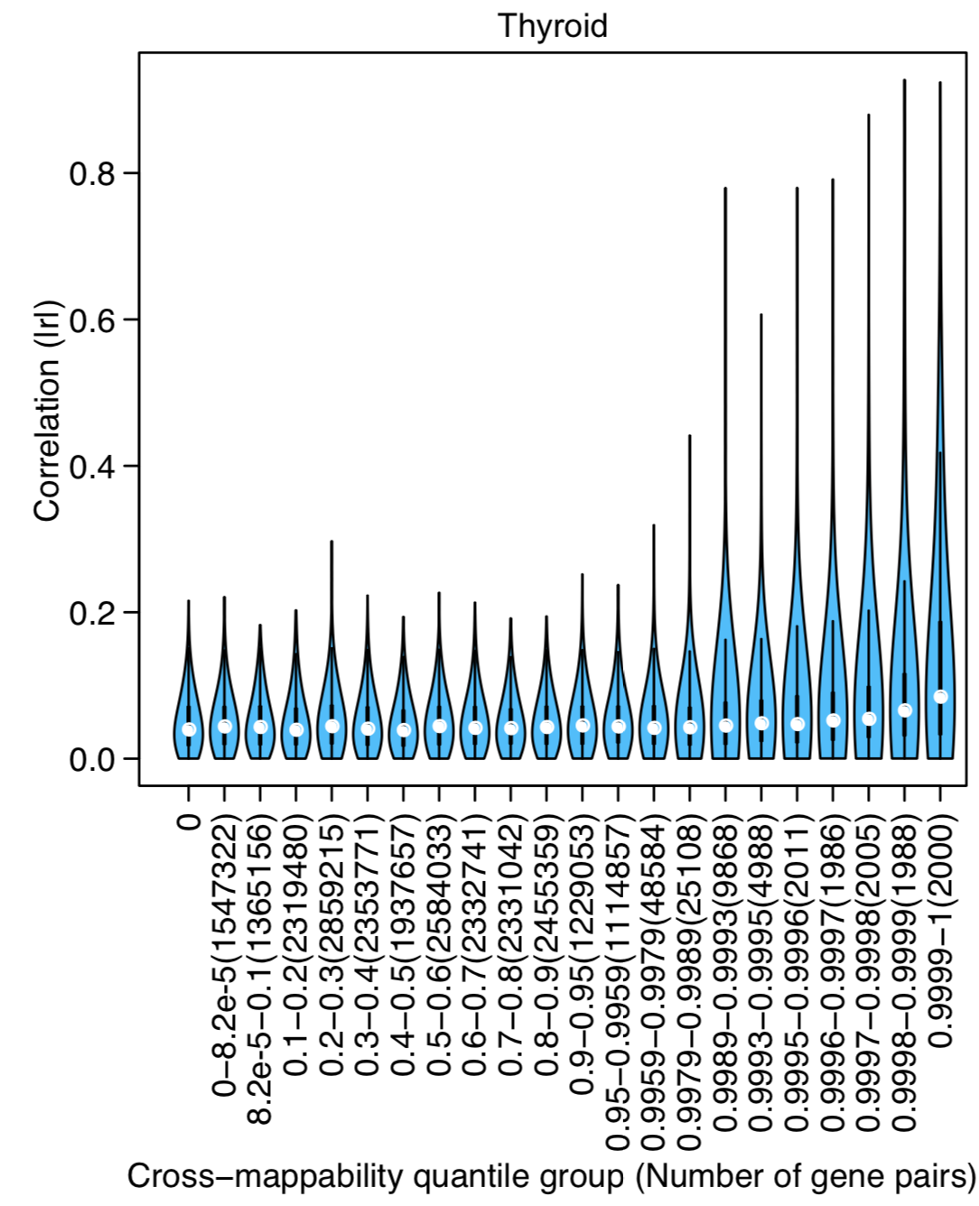
High co-expression between genes with high cross-mappability

Slide 33
Trans-eQTL pipeline^{1,2}
Remove all pseudogenes.
Do not test cross-mappable variant-gene pairs
Improved power by filtering potential false pairs.
1. The GTEx consortium (2017). Genetic effects on gene expression across human tissues. Nature.
2. The GTEx consortium (2020). The GTEx Consortium atlas of genetic regulatory effects across human tissues. Science.

Slide 34
Conclusion
Alignment errors may produce false positives in eQTL and co-expression studies.
Replication studies may be misleading for cross-mappable genes.
We proposed “cross-mappability” metric to quantify the potential mapping error between gene pairs.
We recommend taking necessary steps to avoid false positives.

Slide 35
Acknowledgements
Consortium
Alexis Battle
Princy Parsana
Yuan He
Battle lab members
Sara Mostafavi
﻿François Aguet
Barbara Engelherdt
Brian Jo
﻿Xiaowei Zhu

Slide 36
Cross-mappability: Extra slides

Slide 37
Distribution of cross-mappability

Slide 38
