Slide 1
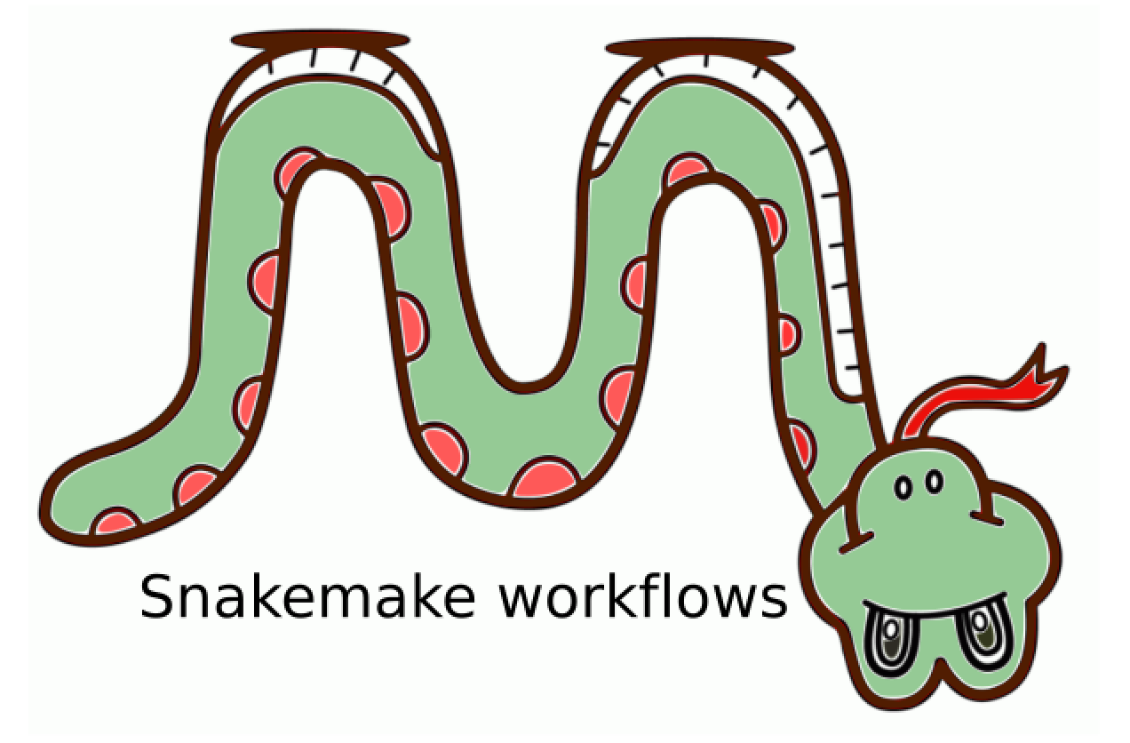
Snakemake Intro
Ashis Saha
29 January 2021
Image source: https://www.physalia-courses.org/courses-workshops/course41/

Slide 2
Overview
What is Snakemake?
Basic syntax
How to run
Advanced syntax
How to run jobs on MARCC?
How to use the template repository?

Slide 3
Snakemake is a workflow management tool
1. What is Snakemake?
Raw Expression (Blood)
Covariate
(Blood)
Corrected Expression (Blood)
Gene Annot
Gene Expression (Blood)
WGCNA Network
SPICE Network
GLasso Network
STRING
mSigDB
Metric-1
Metric-2
Metric-3
Metric-1
Metric-2
Metric-3
Metric-1
Metric-2
Metric-3

Slide 4
Snakemake is a workflow management tool
1. What is Snakemake?
Brain
Blood
Muscle

Slide 5
Expectation: [Given inputs], generate all outputs
1. What is Snakemake?
Which scripts to run?
In which order?
When to run? – Do not run a script before finishing dependencies.
Run automatically.
If possible, run multiple scripts in parallel.
Do not take >12 cores or >55 GB at a time.
Run in cluster?

Slide 6
Expectation: [Given inputs], generate all outputs
1. What is Snakemake?
Scripts failed? Which scripts? What was the errors?
Fixed errors .
Run failed scripts only.
Added one more input.
Run additional or necessary steps only.
Found a bug in a script or data.
Run that script and all dependent scripts.
Reproducible?

Slide 7
Snakemake
2. Basic syntax
Rule
Script
Text based (file based)
Workflow is a set of rules.
Rules specify how to obtain output files from input files.
Written in python
Can run python, R and shell scripts.
Input file
Output file
[dataset.txt]
[dataset.sorted.txt]
rule sort:
input:
"dataset.txt"
output:
"dataset.sorted.txt"
shell:
"sort {input} > {output}"
How to execute? Snakemake -n dataset.sorted.txt

Slide 8
Recursive execution
2. Basic syntax
sort_1
data_1.txt
data_1.sorted.txt
intersect
data_1_2.txt
sort_2
data_2.txt
data_2.sorted.txt
rule sort_1:
input:
"data_1.txt"
output:
"data_1.sorted.txt"
shell:
"sort {input} > {output}"
rule sort_2:
input:
"data_2.txt"
output:
"data_2.sorted.txt"
shell:
"sort {input} > {output}"
rule intersect:
input:
"data_1.sorted.txt",
"data_2.sorted.txt"
output:
"data_1_2.txt"
shell:
"comm -12 {input[0]} {input[1]} > {output}"
How to execute? Snakemake -n data_1_2.txt # final output in 1-step

Slide 9
Wildcard
2. Basic syntax
sort
data_1.txt
data_1.sorted.txt
intersect
data_1_2.txt
sort
data_2.txt
data_2.sorted.txt
rule sort:
input:
"data_{fnum}.txt"
output:
"data_{fnum}.sorted.txt"
shell:
"sort {input} > {output}"
rule intersect:
input:
"data_{fnum1}.sorted.txt",
"data_{fnum2}.sorted.txt"
output:
"data_{fnum1}_{fnum2}.txt"
shell:
"comm -12 {input[0]} {input[1]} > {output}"
How to execute? snakemake –n data_1_2.txt # final output in 1-step
snakemake –n data_1_3.txt # final output in 1-step

Slide 10
Before running Snakemake
3. How to run
Installation: https://github.com/battle-lab/battle-lab-guide/blob/master/marcc_guide/software/install_snakemake.md
Activate Snakemake
module load anaconda # >= v4.6.0
module load python/3.7.4-anaconda # >= v3.7
conda env list # env list
conda activate YOUR/SNAKEMAKE/ENV # activate snakemake env
#conda deactivate # to exit snakemake
Move to project directory
Write all rules in Snakefile or include rule files there (recommended). Snakefile is the default (but configurable) starting point.

Slide 11
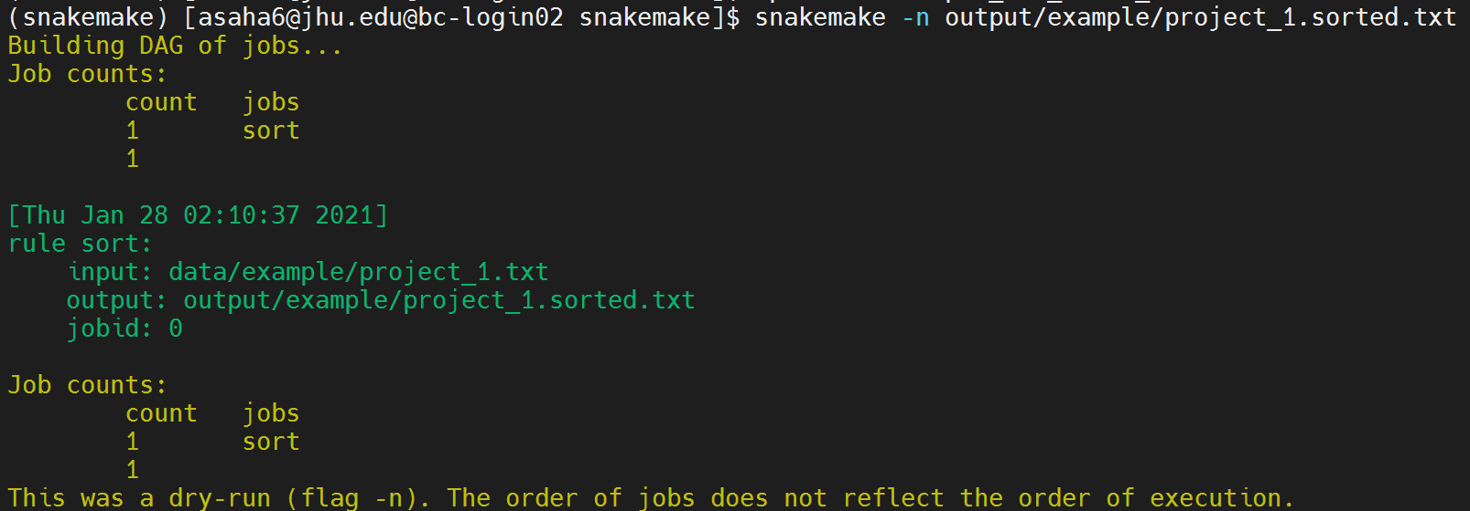
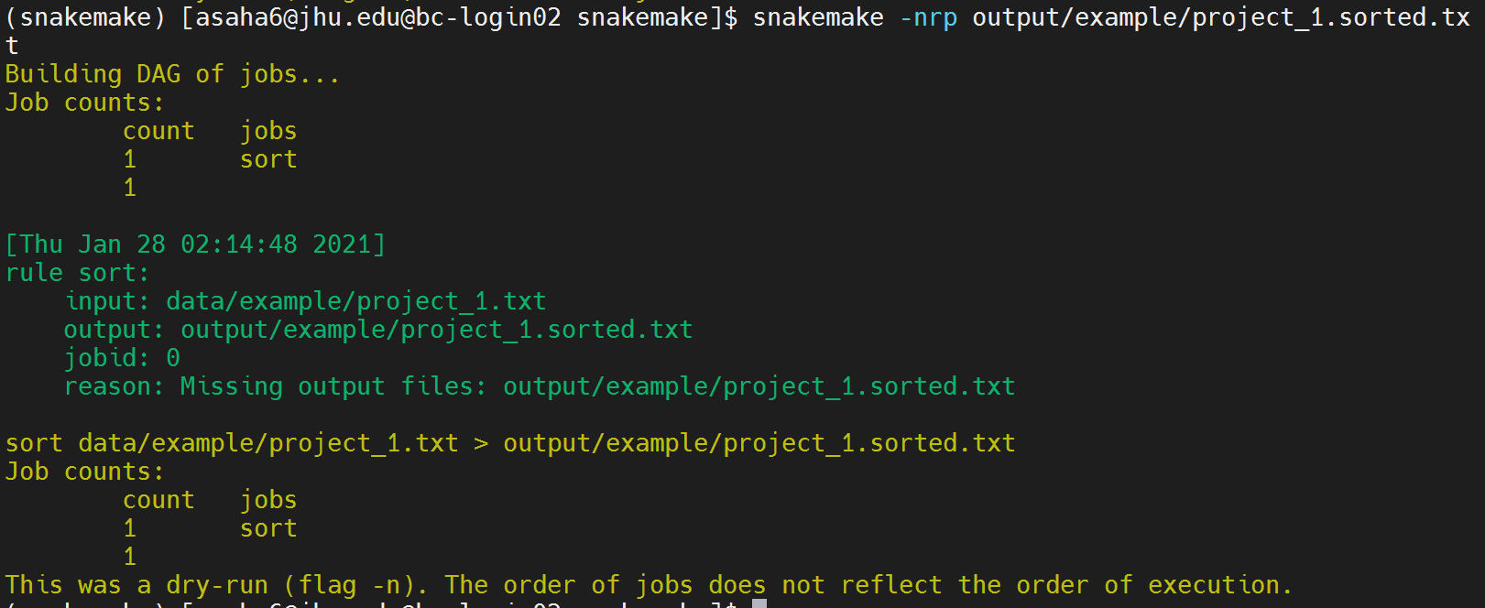
3. How to run
snakemake -n output/example/project_1.sorted.txt
snakemake -nrp output/example/project_1.sorted.txt
-n: do not execute scripts, just test the snakemake code. useful for large workflow.
-r: show reason.
-p: print out shell command.
Parameter description: https://snakemake.readthedocs.io/en/stable/executing/cli.html

Slide 12
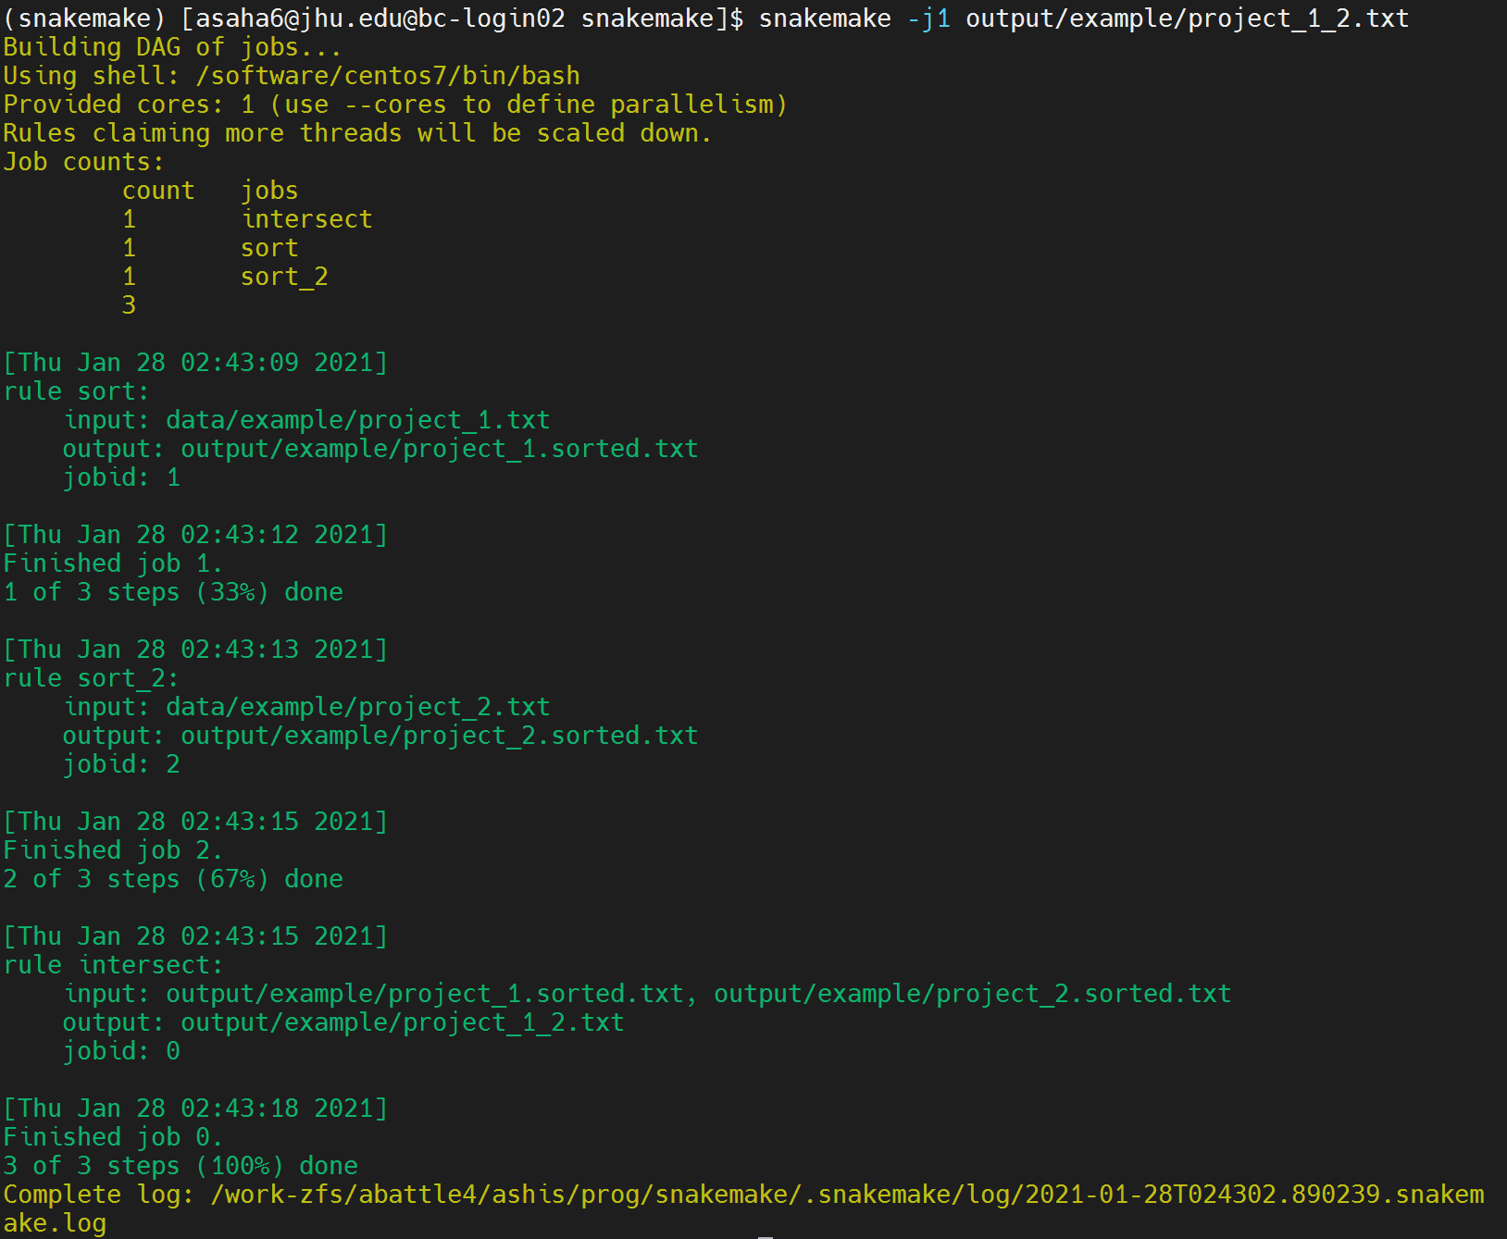
3. How to run
snakemake -j1 output/example/project_1_2.txt
-jN: execute job using at most N cores. Necessary directories are created automatically.
Same command will NOT run scripts, as desired file exists.

Slide 13
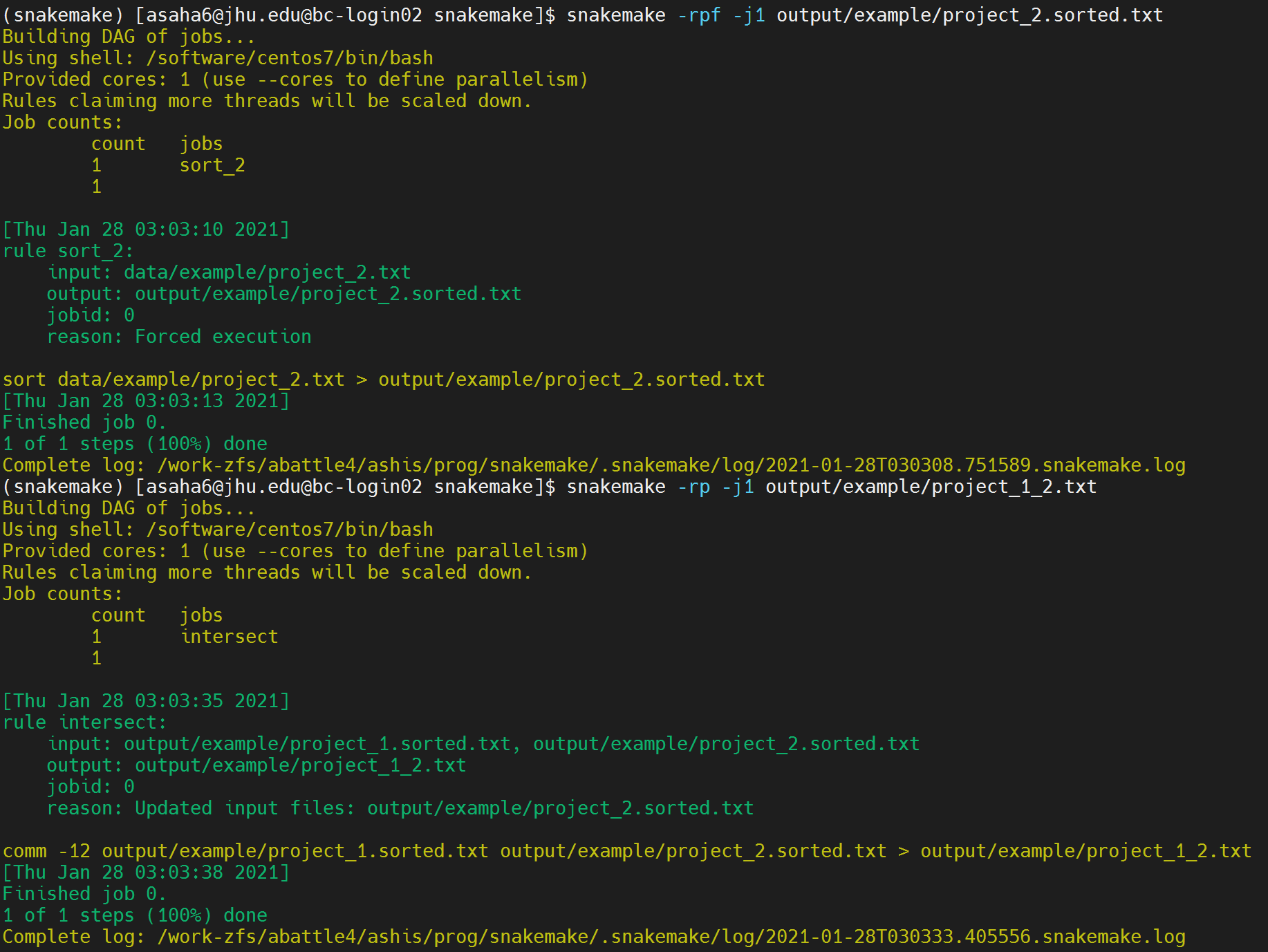
3. How to run
-f: force run. All see “-F” to force recursively.
Now intersection file is outdated, so this script will run.

Slide 14
Important options
3. How to run
-R rulename Force-run a rule. Useful to run a rule after changing the code.
-s path/to/snakefile #default Snakefile Select the main snakemake file.
--profile path/to/profile Run jobs in a cluster [We will see it later]

Slide 15
Python
4. Advanced syntax
rule sort:
input:
a="path/to/{dataset}.txt"
output:
b="{dataset}.sorted.txt"
run:
with open(output.b, "w") as out:
for l in sorted(open(input.a)):
print(l, file=out)

Slide 16
Named input/output
4. Advanced syntax
rule intersect:
input:
"data_{fnum1}.sorted.txt",
"data_{fnum2}.sorted.txt"
output:
"data_{fnum1}_{fnum2}.txt"
shell:
"comm -12 {input[0]} {input[1]} > {output}"
rule intersect:
input:
f1="data_{fnum1}.sorted.txt",
f2="data_{fnum2}.sorted.txt"
output:
"data_{fnum1}_{fnum2}.txt"
shell:
"comm -12 {input.f1} {input.f2} > {output}"

Slide 17
Expand: helper function
4. Advanced syntax
expand("data_{proj}.txt", proj=[“eqtl", "sc"])
= ["data_eqtl.txt", "data_sc.txt"]
expand("data_{proj}_{year}.txt", proj=[“eqtl", "sc"], year=[2019,2020])
= ["data_eqtl_2019.txt", "data_eqtl_2020.txt", "data_sc_2019.txt", "data_sc_2020.txt"]

Slide 18
Expand: helper function
4. Advanced syntax
battle_projects = ["eqtl", "prs", "network", "sc", "randomforest"]
rule project_counts:
input:
expand("data/example/project_{fnum}.txt", fnum=battle_projects)
output:
"output/example/project_counts.txt"
shell:
"cat {input} | sort | uniq -c | sort -k1n > {output}"

Slide 19
config
4. Advanced syntax
File: config.yaml
battle_projects: ["eqtl", "prs", "network", "sc", "randomforest"]
File: Snakefile
configfile: "config.yaml"
rule project_counts:
input:
expand( "data/example/project_{fnum}.txt", fnum=config["battle_projects"])
output:
"output/example/project_counts.txt"
shell:
"cat {input} | sort | uniq -c | sort -k1n > {output}"

Slide 20
First rule
4. Advanced syntax
If the target output is not specified, snakemake runs the first rule.
Tips: define the first rule with only input where input = array of all final outputs. Then snakemake will by default run everything.
configfile: "config.yaml“
rule all:
input = "output/example/project_counts.txt"
rule project_counts:
input:
expand( "data/example/project_{fnum}.txt", fnum=config["battle_projects"])
output:
"output/example/project_counts.txt"
shell:
"cat {input} | sort | uniq -c | sort -k1n > {output}"

Slide 21
Profiles
4. Advanced syntax
Helps run jobs in different environments (e.g., clusters)
Open-source profiles available in github: https://github.com/Snakemake-Profiles
snakemake --profile path/to/profile –j10

Slide 22
Logging
4. Advanced syntax
File: config.yaml
battle_projects: ["eqtl", "prs", "network", "sc", "randomforest"]
File: Snakefile
configfile: "config.yaml"
rule project_counts:
input:
expand( "data/example/project_{fnum}.txt", fnum=config["battle_projects"])
output:
"output/example/project_counts.txt"
log:
"output/log/project_counts.log"
shell:
"cat {input} | sort | uniq -c | sort -k1n > {output} 2> {log}"

Slide 23
Params: convenience (good for static parameters, derived parameters)
4. Advanced syntax
rule project_counts:
input:
expand("{input_dir}/project_{fnum}.txt", input_dir = config["input_dir"], fnum=config["battle_projects"])
output:
"{output_dir}/counts.txt"
params:
sleep_time = "30s",
exit_msg = "output saved in {output_dir}/counts.txt. exiting ..."
shell:
"""
cat {input} | sort | uniq -c | sort -k1n > {output}
echo "sleeping ..."
sleep {params.sleep_time}
echo {params.exit_msg}
"""

Slide 24
Input functions
4. Advanced syntax
configfile: "config.yaml"
rule all:
input:
expand("{dataset}.sorted.txt", dataset=config["datasets"])
rule sort:
input:
lambda wildcards: config["datasets"][wildcards.dataset]
output:
"{dataset}.sorted.txt"
threads: 4
resources: mem_mb=100
shell:
"sort --parallel {threads} {input} > {output}"

Slide 25
Include files
4. Advanced syntax
Write rules in a separate file and include it in the main file.
Works as if the included file was written in the main file.
configfile: "config.yaml"
rule all:
input = "output/example/project_counts.txt"
include: "rules/example_set_basic_2.smk"

Slide 26
Threads and Resources
4. Advanced syntax
rule bwa:
input:
"data/genome.fa",
"data/samples/{sample}.fastq"
output:
temp("mapped/{sample}.bam")
conda:
"envs/mapping.yaml"
threads: 8
resources:
runtime_min=240,
mem_mb=1000
shell:
"bwa mem -t {threads} {input} | samtools view -Sb - > {output}"

Slide 27
Not covered, but important
4. Advanced syntax
Modularization
Conda environment
Cloud execution
Highly recommend the tutorial: https://snakemake.readthedocs.io/en/stable/tutorial/tutorial.html

Slide 28
MARCC Profile
5. How to run jobs on MARCC
I copied the SLURM profile and edited to make it work on MARCC: https://github.com/battle-lab/snakemake
You may use it as a template to start your project.
Important files:
profiles/marcc/config.yaml: Global configuration for MARCC
profiles/marcc/ cluster_config.yaml: Jos-specific configuration

Slide 29
Load modules on marcc
5. How to run jobs on MARCC
# following code loads modules on marcc before running each job.
# it may produce error message in other systems or local computers,
# but should not stop execution.
shell.prefix("module load R/4.0.2; module load python/3.8; ")

Slide 30
A few good practices
5. How to run jobs on MARCC
Keep related rules in the same file.
Keep all rue files in the same directory (rules), possibly categorized by subdirectories.
Keep Snakefile clean.
Include rule files from Snakefile.
Keep only one rule in Snakefile mentioning all output files from the project.
Keep all logs in a directory categorized by rule names.
Easy to find errors.
Do not mix codes to run jobs in cluster and in local computers.

Slide 31
Execution graph
snakemake --forceall --dag | dot -Tpdf > output/example/dag.pdf

Slide 32
Questions?
Thank you!

